Slide 1



VMG/AAHA Chart of Accounts Changes
Beth Scott, CPA
November 2025

Slide 2

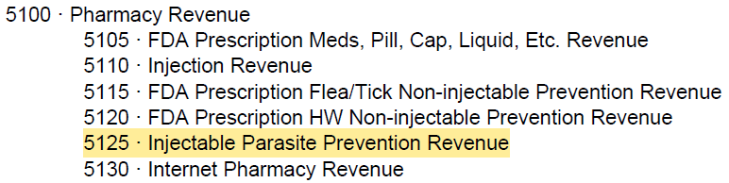
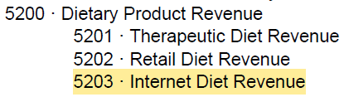
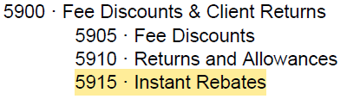
Category Additions - REVENUE
5125 – Injectable Parasite Prevention Revenue
5203 – Internet Diet Revenue
5915 – Instant Rebates

Slide 3
Definitions for Revenue Category Additions
5125 · Injectable Parasite Prevention Revenue
This revenue center includes income from any injectable FDA product that prevents infestations associated with heartworms fleas, ticks, intestinal and external parasites. These injections can target individual parasite types or a combination of parasite types. Example: ProHeart® 6 & 12 month and Bravecto Quantum®.
5203 · Internet Diet Revenue
This revenue center includes gross revenues resulting from dietary sales made through a practice via portal regardless of whether it is through a subcontracted vendor (Hills to Home, Purina, vRxPro, VetSource, etc.) Also include income from dietary products billed by the practice but shipped directly to the client. Note: Internet sales are not generated through the practice’s PIMs, therefore, this revenue center does not need to be set up in your practice’s PIMs.
5915 · Instant Rebates
Hospitals that discount invoices for instant rebates reimbursed by manufacturers should use this category to capture the discounts from the practice management reports. When deposits (rebate checks) are received from the vendor (i.e. Greenline) they should also be credited to this account in the accounting software (not PIMs). The expectation would be that when reviewing the detail of this account you will see discounts reflected but then also see an offsetting deposit to zero out the balance in this account. Note that these instant rebates are not to be confused with discounts that vendors may call “rebates.”

Slide 4
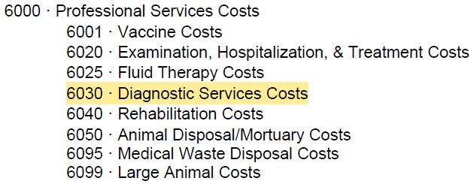
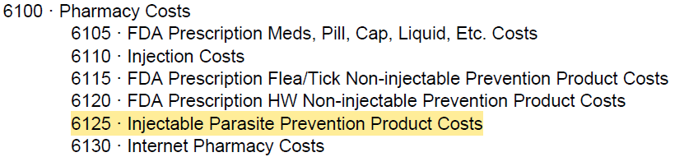
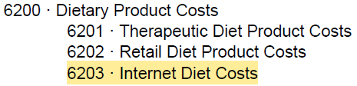
Category Additions - EXPENSES
6030 – Diagnostic Services Costs
6125 – Injectable Parasite Prevention Product Costs
6203 – Internet Diet Costs

Slide 5
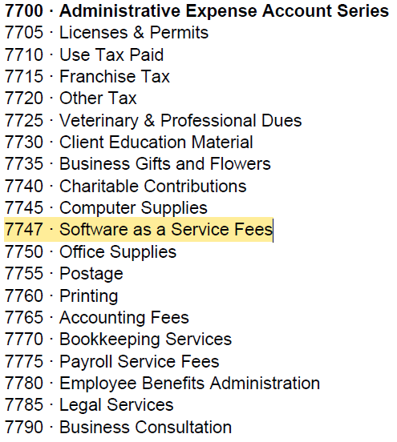
Category Additions - EXPENSES
7747 – Software as a Service Fees

Slide 6
Definitions for Expense Category Additions
6030 · Diagnostic Services Costs
Includes expenses associated with blood pressure measurement, EKG/ECG tracing procedures (including Holter monitor use), ophthalmology-related tests (tear/lacrimation testing, corneal staining procedures, intraocular pressure measurement), bone marrow aspiration procedures, water deprivation tests, Tensilon tests, CSF tap procedures, diagnostic abdominocentesis or thoracentesis procedures, intradermal allergy testing and necropsy procedure. Expenses associated with EKG/ECG consults are also included here.
6125 · Injectable Parasite Prevention Product Costs
Includes cost of injectable products that prevent fleas, ticks or heartworms, such as Proheart or Bravecto injectable.
6203 · Internet Diet Costs
Includes the cost of diets resulting from sales made through a web portal either belonging to the practice or a subcontracted vendor such as Hills to Home, Purina, Vetsource, vRxPro etc. Subcontracted vendors usually pay the practice the net sales made to clients, so you want to capture to the gross sales in account 5203 Internet Diet Revenue and the related cost here to get the net amount recorded in your financials and bank account.

Slide 7
Definitions for Expense Category Additions
7747 · Software as a Service Fees
Includes a wide variety of office and general practice support subscription fees such as Adobe, Calendly, Vetstoria, Office 365, Google Drive, Drop Box, Visvet, PIMS subscription fees, Zoom, Whentowork, WhenIwork, Scribblevet, CoVet, etc. These do not include remote employees such as live scribes, which should be allocated to contract labor.

Slide 8
New Parent Account GL Codes
7200 Employer Payroll Taxes Account Series
7700 Administrative Expense Account Series
7800 Advertising & Promotion Expense Account Series
7900 Fee Income Collection Expense Account Series

Slide 9
Category Name Changes
5115 FDA Flea/Tick (Non-HW; Non-Injectable) Parasite Control Prevention Revenue
5120 FDA Prescription HW or Combination HW/Parasite (Non-Injectable) Control Prevention Revenue
6115 FDA Prescription Flea/Tick (Non-HW; Non-Injectable) Control Prevention Product Costs
6120 FDA Prescription HW or Combo HW/Parasite (Non-Injectable) Control Prevention Product Costs
6420 Specialist (Imaging) Consultation Costs
7303 Group Dental, Vision and Other Insurance Premium Expense
7400 Study and Buying Group Fees
7915 CareCredit Third Party Financing Service Fees
9200 State Income Tax Provision/Pass Through Entity Tax (PTET)

Slide 10
Definition Updates
CURRENT
5010 · Exam Revenue
This revenue center includes outpatient exams, consultations, services, nail trims, anal glands and ear cleaning (not associated with grooming); minor outpatient treatments, poison control consultation fees, outpatient wound care, microchip implantation and health certificates. More extensive diagnostic procedures completed at time of examination, such as hematology and serum chemistry tests, are coded to laboratory revenues, whether conducted on an inpatient or an outpatient basis. Euthanasia services are included in this account (do not include mortuary services; see account 5050).
NEW
5010 · Exam Revenue
This revenue center includes outpatient exams, consultations, and many professional services that are performed during the exam, such as nail, wing and teeth trims, anal gland expression, minor ear cleaning, soft paw application, diabetic glucose sensor application, outpatient medication administration fees, poison control consultation fees, telemedicine exam/consults, microchip implantation, health certificates, house call fees, euthanasia services and euthanasia solution. More extensive diagnostic procedures completed at time of examination are tracked elsewhere.

Slide 11
Definition Updates
NEW
5020 · Hospitalization & Treatment Revenue
This revenue center includes hospitalization (day or night), and inpatient services. Includes critical and nursing care, oxygen (even though the cost for oxygen is tracked under 6600 Anesthesia), in-patient medication administration, heat support, stomach tubing and lavage, enemas, continuous blood pressure monitoring (not to be confused with diagnostic blood pressure measurement), heartworm treatment support, tattoo services, bandages, casts, urinary catheterization, therapeutic abdominocentesis and thoracentesis, inpatient non-surgical wound care. Includes theriogenology services such as semen collection and preparation, insemination, obstetrical assistance, and neonatal care and stem cell therapy. Track medical boarding here and medication administration for boarding pets. If your practice offers minimal boarding services, please track these boarding services under 6020 Prof. Services Hospitalization & Treatments. Inventory items sold to clients and/or used in-house/for treatments are also tracked here, i.e., syringes), needles, vet wrap and other bandage supplies, cotton balls, tongue depressors, etc.
CURRENT
5020 · Hospitalization & Treatment Revenue
This revenue center includes hospitalization (day or night), and inpatient services. Includes professional care, critical care, nursing care, oxygen, heat support, stomach tubing and lavage, enemas, continuous blood pressure monitoring, heartworm treatment support, tattoo services, bandages, casts, urinary catheterization, therapeutic abdominocentesis or thoracentesis, inpatient non-surgical wound care. Includes theriogenology services such as semen collection and preparation, insemination, obstetrical assistance, and neonatal care. Also includes Stem Cell Therapy.

Slide 12
Definition Updates
CURRENT
5030 · Diagnostic Services Revenue
This revenue center includes fees charged for blood pressure measurement, EKG/ECG tracing procedures (including Holter monitor use), ophthalmology-related tests (tear/lacrimation testing, corneal staining procedures, intraocular pressure measurement), bone marrow aspiration procedures, water deprivation tests, Tensilon tests, CSF tap procedures, diagnostic abdominocentesis or thoracentesis procedures, intradermal allergy testing and necropsy procedure.
NEW
5030 · Diagnostic Services Revenue
This revenue center includes fees charged for blood pressure measurement, EKG/ECG tracing procedures performed in-house or by outside services (including Holter monitor), EKG/ECG consults, ophthalmology-related tests (tear/lacrimation tests, corneal staining procedures, intraocular pressure measurement), bone marrow aspiration procedures, water deprivation tests, tensilon tests, CSF tap, diagnostic abdominocentesis or thoracentesis procedures, intradermal allergy testing when performed in-house and necropsy procedure.

Slide 13
Definition Updates
CURRENT
5110 · Injection Revenue
This revenue center includes income from FDA inpatient and outpatient injections and any injection fee and any associated packing/dispensing fees. Insulin, Immiticide and Cytopoint are included in this account as well as hyposensitization treatment (allergy) injections. Does not include income from injection for anesthetics, analgesics, tranquilizers, anxiolytic agents, sedating agents, euthanasia solutions, flea preventative or injectable heartworm preventatives. See 5600-Anesthesia for details on items included in the Anesthesia revenue center; injectable heartworm preventatives should be coded as 5120 FDA RX Heartworm/Heartworm Combo.
NEW
5110 · Injection Revenue
This revenue center includes income from FDA inpatient and outpatient injections and any injection fee and any associated packing/dispensing fees. Insulin, Immiticide®, Cytopoint®, Solensia®, and Librela® are included in this account as well as FDA hyposensitization treatment (allergy) injections. Does not include income from injectable anesthetics, analgesics, tranquilizers, anxiolytic agents, sedating agents, euthanasia solutions or injectable heartworm preventatives. See 5600 Anesthesia, Sedatives, and Tranquilizers for details on items included in the Anesthesia revenue center; injectable parasite preventatives should be coded as 5125 FDA RX Injectable Parasite Prevention.

Slide 14
Definition Updates
CURRENT
5115 · FDA Prescription Flea/Tick (Non-HW) Parasite Control Revenue
This revenue center includes income from FDA prescription products that prevent fleas and/or ticks, but not heartworms. Example: Comfortis, Program, Credelio, NexGard & Bravecto chews.
NEW
5115 · FDA Prescription Flea/Tick Non-Injectable Prevention Revenue
This revenue center includes income from FDA prescription products that prevent fleas and/or ticks, but not heartworms, and excludes injectable forms (injectable parasite control products are coded to 5125). Example: Comfortis®, Simparica®, Credelio®, NexGard® & Bravecto® chews. Note that non-FDA Flea/Tick preventatives are tracked under 5803 Ancillary non-FDA Flea & Tick Products and includes items such as Frontline®, Seresto®, Capstar®, Vectra®, and others.

Slide 15
Definition Updates
CURRENT
5120 · FDA Prescription HW or Combination HW/Parasite Control Revenue
This revenue center includes income from any FDA product that prevents heartworms or combo HW and other internal or external parasites. Example: Sentinel, Trifexis, Heartguard, Advantage Multi, Revolution, and ProHeart 6.
NEW
5120 · FDA Prescription HW Non-Injectable Prevention Revenue
This revenue center includes income from any orally or topically administered (non-injectable) FDA Rx product that prevents heartworms or combination of heartworms, fleas, ticks, intestinal and external parasites. Example: Sentinel®, Trifexis®, Heartgard®, Advantage Multi®, Revolution®, Simparica Trio®, Bravecto Plus®, NexGard Combo®. (Injectable parasite control products are coded to 5125).

Slide 16
Definition Updates
NEW
5880 · Wellness/Pre-Paid Plans Revenue
This revenue center includes payments for services consumed under wellness plans. Example: Enrollment fees, cancellation fees, monthly payments towards wellness plans.
At the time of payment for wellness/pre-paid plans, if you are using a third party to administer your plan, in most cases you will not record the payment received in the practice management system. Instead, you will only need to record a deposit in your accounting system to this account. If you are NOT using a third party to administer your wellness plans, then you will record the receipt of payment in your practice management system. You will generate an invoice with a line item and the exact amount paid to this account.
CURRENT
5880 · Wellness/Pre-Paid Plans Revenue
This revenue center includes payments for services consumed under wellness/pre-paid plans.

Slide 17
Definition Updates
CURRENT
5885 · Wellness/Pre-Paid Plans Adjustments
This revenue center includes adjustments applied to invoices for services consumed under wellness/pre-paid plans.
NEW
5885 · Wellness/Pre-Paid Plans Adjustments
This revenue center includes adjustments applied to invoices for services consumed under wellness/pre-paid plans.
At the time that wellness plan services are provided, generate a normal invoice with all services performed and/or products sold during the visit. The amount that being applied to the invoice from the client’s wellness plan or pre-payment plan should be reported as a negative line item on the invoice that is attributed to this account in the accounting software. If all services/products for the visit are covered under the client’s plan the net amount due for the invoice should be ZERO.

Slide 18
Definition Updates
CURRENT
6110 · Injection Costs
This account is used to track FDA injectable medications invoiced as pharmacy injection income. It does include insulin and Immiticide injections. It excludes IV Fluids (code to account 6025), vaccines (code to account 6001), FDA parasiticides such as; Program (code to account 6120), euthanasia solutions (code to account 6020) and anesthetic/sedating agents (code to account 6600).
NEW
6110 · Injection Costs
This account is used to track FDA injectable medications invoiced as pharmacy injection income. It does include insulin and Immiticide injections. It excludes IV Fluids (code to account 6025), vaccines (code to account 6001), FDA parasiticides such as; Proheart (code to account 6125), euthanasia solutions (code to account 6020) and anesthetic/sedating agents (code to account 6600).

Slide 19
Definition Updates
CURRENT
6115 · FDA Prescription Flea/Tick (Non-HW) Parasite Control Product Costs
Record costs for FDA prescription products that prevent fleas and/or ticks, but not heartworms. Examples of product purchases to record in this account include Comfortis, Program, NexGard & Bravecto.
NEW
5115 · FDA Prescription Flea/Tick Non-Injectable Prevention Revenue
Includes non-injectable FDA prescription products that prevent fleas and/or ticks, but not heartworm. Examples: Comfortis, Nexgard, and Bravecto. Injectable products are coded to 6125.

Slide 20
Definition Updates
CURRENT
6120 · FDA Prescription HW or Combo HW/Parasite Control Product Costs
Include purchases of any FDA product that prevents heartworms or combination products that prevent heartworms and other internal or external parasites. Examples of costs to record in this account include Sentinel, Trifexis, Heartgard, Advantage Multi, Revolution, and ProHeart-6.
NEW
6120 · FDA Prescription HW Non-Injectable Prevention Product Costs
Includes purchases of any non-injectable FDA product that prevents heartworms or combination products that prevent heartworms and other internal or external parasites. Examples: Sentinel, Trifexis, Heartguard, Advantage Multi, and Revolution. Injectable products are coded to 6125.

Slide 21
Definition Updates
CURRENT
6420 · Specialist (Imaging) Consultation Costs
If radiology services are provided off-site by a boarded radiologist or radiology service, those consultation costs should be recorded here. However, if the consultation is performed at your hospital by a boarded radiologist, their wages should be included in 7085.
NEW
6420 · Imaging Consultation Costs
If radiology services are provided off-site by a boarded radiologist or artificial intelligence radiology service, those consultation costs should be recorded here. However, if the consultation is performed at your hospital by a boarded radiologist, their wages should be included in 7085.

Slide 22
Definition Updates
CURRENT
7303 · Group Dental Insurance Premium Expense
NEW
7303 · Group Dental, Vision and Other Insurance Premium Expense
Includes insurance premiums to cover dental and vision care, Employee Assistance Plans, and any other types of insurance offered to employees that are not categorized elsewhere.

Slide 23
Definition Updates
CURRENT
7580 · Property, Casualty, & Liability Insurance Premiums
Code premium expenses for liability insurance on the facility, inventory, contents, and business overhead insurance (BOI; sometimes called disability overhead insurance).
Umbrella liability premiums are also coded to this account.
Professional liability insurance should be coded to account 7320, and employment practices liability insurance should be coded to account 7470.
Vehicle insurance premiums are expensed in 7620.
Workers’ compensation insurance premiums (or tax) are coded to 7340.
NEW
7580 · Property, Casualty, & Liability Insurance Premiums
Code premium expenses for liability insurance on the facility, inventory, contents, and business overhead insurance (BOI; sometimes called disability overhead insurance).
Umbrella liability and cyber liability premiums are also coded to this account.
Professional liability insurance should be coded to account 7320, and employment practices liability insurance should be coded to account 7470.
Vehicle insurance premiums are expensed in 7620.
Workers’ compensation insurance premiums (or tax) are coded to 7340.

Slide 24
Definition Updates
CURRENT
7710 · Use Tax Paid
Use tax paid on applicable purchases can be allocated to the appropriate expense category rather than using this account, if you prefer. For example, use tax paid to the state and associated with the purchase of non-taxed office supplies could be classed to account 7750 – Office Supplies.
In all cases, the allocated amount of use tax paid on the purchases of capital assets, such as equipment, should be included in the same fixed asset account as the original purchase. For example, $2,100 of use tax paid on the acquisition of a $35,000 ultrasound machine should be coded to account 2000 - Professional Equipment. The total effective capitalized price of $37,100 is then subject to depreciation. Do not segregate sales tax from the cost of supply acquisition. Sales tax assessed by vendors on goods, services, and equipment sold to the practice is part of the asset’s cost and is never classed to a separate account.
NEW
7710 · Use Tax Paid
Use tax paid on applicable purchases can be allocated to the appropriate expense category rather than using this account, if you prefer. For example, use tax paid to the state and associated with the purchase of non-taxed office supplies could be classed to account 7750 – Office Supplies.
In all cases, the allocated amount of use tax paid on the purchases of capital assets, such as equipment, should be included in the same fixed asset account as the original purchase. For example, $2,100 of use tax paid on the acquisition of a $35,000 ultrasound machine should be coded to account 2000 - Professional Equipment. The total effective capitalized price of $37,100 is then subject to depreciation. Do not segregate sales tax from the cost of supply acquisition. Sales tax assessed by vendors on goods, services, and equipment sold to the practice is part of the asset’s cost and is never classed to a separate account. Sales tax collected from clients goes into account 3400 sales tax payable.

Slide 25
Definition Updates
CURRENT
7715 · Franchise Tax
Record state franchise, commercial activity, or other similar state tax payments to this account.
NEW
7715 · Franchise Tax
Record state franchise, commercial activity, or other similar state tax payments to this account. This does not include pass through entity tax or individual estimated tax.

Slide 26
Definition Updates
CURRENT
7720 · Other Tax
Use this account to record other taxes levied on the practice that do not appropriately fit elsewhere. Note well: payroll taxes, workers compensation premiums/tax, corporate income taxes, real estate taxes, personal property taxes, etc. should all be coded elsewhere.
NEW
7720 · Other Tax
Use this account to record other taxes levied on the practice that do not appropriately fit elsewhere. Note well: payroll taxes, workers compensation premiums/tax, corporate income taxes, real estate taxes, personal property taxes, etc. should all be coded elsewhere. This does not include pass through entity tax or individual estimated tax.

Slide 27
Definition Updates
CURRENT
7910 · Credit Card Merchant Service Fee Expense
Client credit card payment of veterinary invoices results in fees assessed to the practice. This account is used to code payments made to or withheld by MasterCard, VISA, American Express, Discover, and similar consumer credit cards.
NEW
7910 · Credit Card Merchant Service Fee Expense
Client credit card payment of veterinary invoices results in fees assessed to the practice. This account is used to code payments made to or withheld by MasterCard, VISA, American Express, Discover, Apple Pay and similar consumer credit cards. Also include any fees paid to PayPal or Venmo for processing client payments.

Slide 28
Definition Updates
CURRENT
9200 · State Income Tax Provision
Record here the state income tax liability associated with the practice entity’s taxable income, which must be paid by the entity. Taxes owed by practice owners are not recorded on the practice’s books. This tax is not a payroll, sales, or property franchise tax. These taxes should be coded elsewhere.
NEW
9200 · State Income Tax/Pass Through Entity Tax (PTET)
Record here the state income tax liability associated with the practice entity’s taxable income, which must be paid by the entity. This account will also include any state Pass-Through Entity Tax (PTET) payments made by the hospital on behalf of the owners. Taxes owed by practice owners are not recorded on the practice’s books. This tax is not a payroll, sales, or property franchise tax. These taxes should be coded elsewhere.

Slide 29
Definition Updates
In addition to the definition updates noted in the previous slides, all revenue definitions were revised to remove ambiguities and clarify what belongs in what revenue account. These revisions are all encompassed in the revenue and expense field definitions but are not necessarily reflected in this summary unless there was a significant change/addition.

Slide 30
Member Education Needs
Practices DO NOT have to use all of the subaccounts as laid out if you have no interest in tracking these items separately. For example, many practice owners do NOT track the different Utilities separately. Additionally, you can add in your own additional subaccounts for more granular tracking as long as they roll up into the proper parent category. For example, some practice owners have subaccounts for the different parasiticides under 5115/6115 & 5120/6120.
This was already included in the book document on page 53 at the top.
The more detailed revenue subaccounts can be organized and modified in accord with the practice’s unique needs, as determined by practice owners. These needs can and will change over time, driving adaptation of accounting data collection and organization techniques through a flexible chart of accounts. Each additional account that a practice chooses to add or adapt should be set as an account under one of the general account headings.
Small equipment (<$2500 in price). DO NOT to create a catchall category for this but expense small equipment in the category that it is used in. For example:
  6020 Examination, Hospitalization & Treatment Costs- Electronic thermometer
  6025 Fluid Therapy Costs- Fluid pumps
  6500 Surgery Costs- Surgery instruments
  7745 Computer Supplies- Computers
  7750 Office supplies- Office equipment <$2500
This is now included on page 68
Sales tax collected on veterinary products and services is neither a revenue or expense item. Refer to the explanation of 3400 Sales and Use Tax Payable in the Chart of Accounts
Added to definition of 7710. This was also part of the Tip 1 under the definition for account 3400
When comparing In house lab costs between practices, keep in mind that costs can be greatly influenced by the proportion of lab tests done on machines with high reagent and overhead costs versus those that have very little costs such as skin and ear cytology.
Added as a tip under 6301 in-house lab
If you do not offer grooming, consider make 6850 Grooming Costs a subcategory of 6000 Professional Services Costs so that when distributors itemize items (like clipper blades) to Grooming Costs they will go to Professional Services in Datalink instead.
Added as a tip under 6850 grooming
Product rebates
  Rebates that are paid by product vendors based on wholesale purchases should be applied as a credit against product purchase costs.
This was already in tip 5 on page 68 in the book
  Greenline rebates that are applied as a discount to the client invoice should be categorized in bookkeeping software as a debit under 5915 Greenline Rebates. When the rebate is deposited it will be entered as a credit to that account, cancelling out the debit.
Added this as a tip under Greenline definition

Slide 31

Beth Scott
CPA
bscott@ksmcpa.com

